Slide 1
Accreditation Journey
Mentor’s Perspective
Mohamed T. Madi
Interim Dean, College of Business & Economics, UAEU.

Slide 2
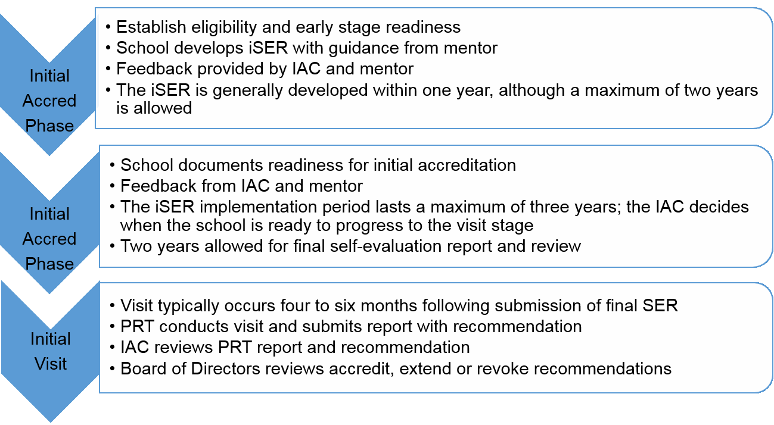
The Journey

Slide 3
Mentor Assignment
Joins the journey in its early stage
Assigned as soon as the eligibility application is accepted.
Appointed by the IAC/AAC Chair
If the school is allowed to move directly to the SER stage, no mentor is assigned.

Slide 4
Two Critical Phases
The mentor assists the school in 2 phases;
Initial self evaluation report
iSER action implementation/Gap closing

Slide 5
Mentor’s Role
Help develop a better understanding of the standards among school stakeholders
Advise the School on the self-assessment process and development of iSER
Stimulate the School to define its processes, activities, and outcomes

Slide 6
Responsibilities
To the School
Clarify standards intent and interpretation within mission context
To AACSB
Consult with AACSB and identify significant problems in the process
Be available regularly
Visit the School and provide feedback
Be encouraging, honest, and realistic
Report regularly on progress
Provide iSER critique & recommendation on acceptance

Slide 7
School-Mentor Relationship
Mutual sincerity, frankness, and transparency
Mutual respect & responsiveness
Open discussions on strengths & weaknesses
Team spirit

Slide 8
Handoff to the PRT Chair
The Mentor’s mission ends when IAC/AAC directs the School to complete the application for an initial accreditation visit.
PRT Chair is appointed
The chair replaces the mentor to assist the School with the development of the final SER

Slide 9
Thank you

