Slide 1
AACSB International Membership & Quality Assurance
Timothy S. Mescon, Ph.D. Sr. VP and Chief Officer- EMEA
January 2017
Sakarya University

Slide 2
AACSB International Organization Founded 1916
Nonprofit organization
Americas Office in Florida in the USA
Offices in Singapore (Asia-Pacific) and Amsterdam (Europe, Middle East and Africa)
Total 80 employees
1250 volunteer assignments annually

Slide 3
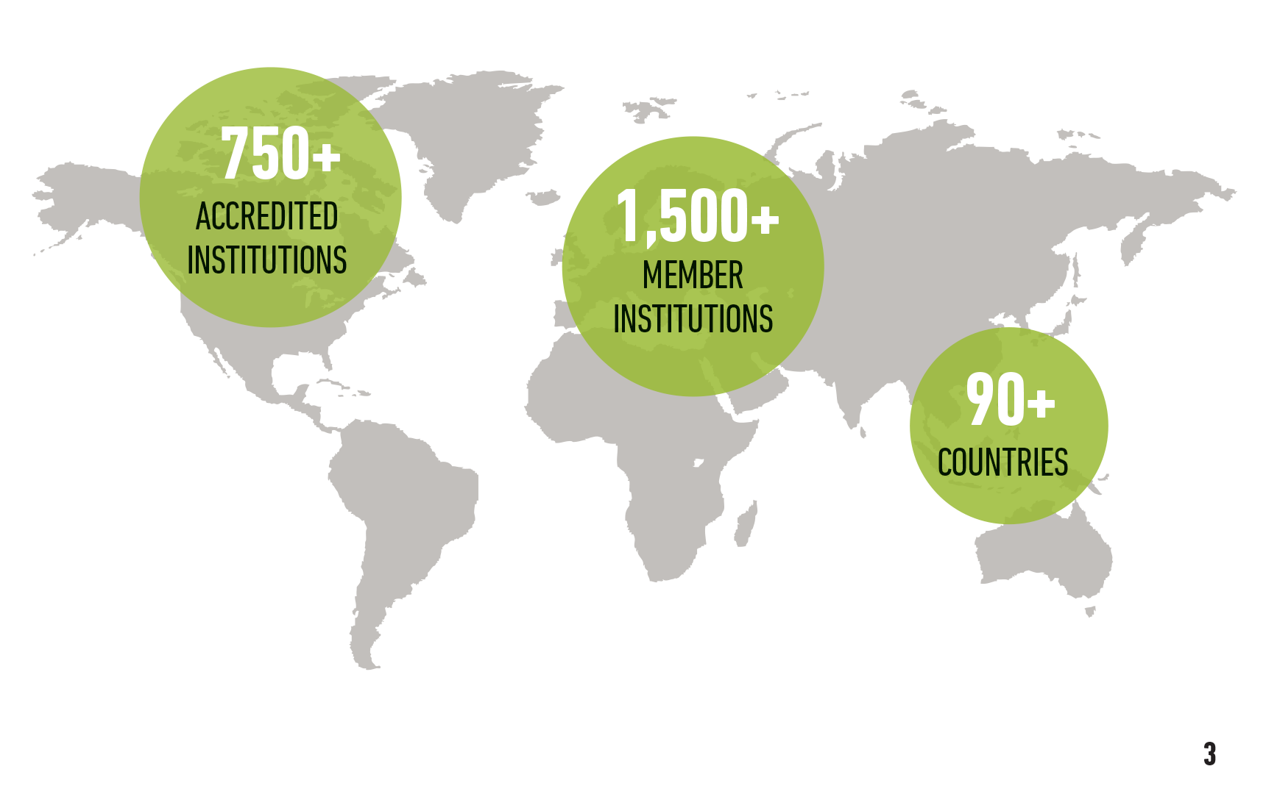
AACSB Worldwide

Slide 4
The AACSB Landscape
1,553
779
1,491
62
53
97
185
IN 2015-16,
88
5
Notes:
The AACSB Landscape:
Total Members: 1,553
Educational Members: 1,491
Business Members & Management Associations: 62
Total Countries/Territories: 97
779 accredited business schools in 53 countries
185 holding accounting accreditation in 8 countries
Events
SEMINARS: Public Seminars: 75 spanning 5 continents, 16 countries/territories.
CONFERENCES: There were 13 conferences in the following countries: U.S., Peru, China, Germany, Singapore, Italy

Slide 5
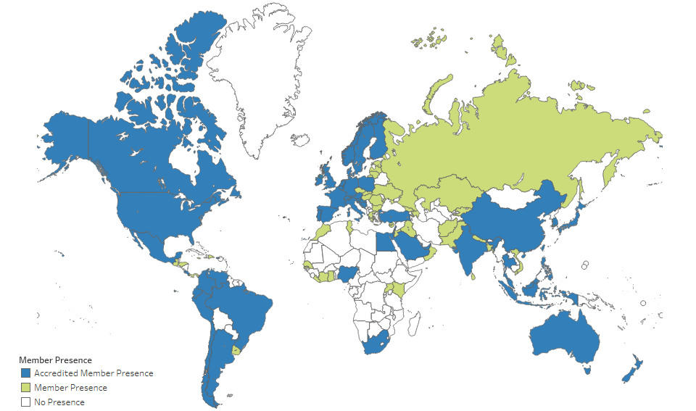
AACSB Membership Reach

Slide 6
Impact of AACSB
80+
professional development events annually
40,000+
thought leaders, educators, volunteers, & business innovators.
serving
3 million+
enrolled students
supporting
100,000+
full-time faculty

Slide 7
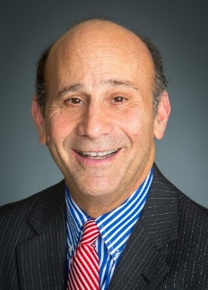
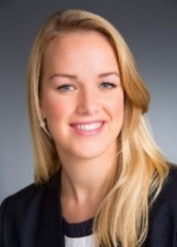
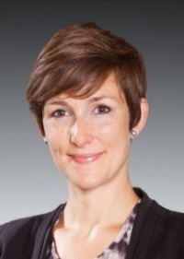
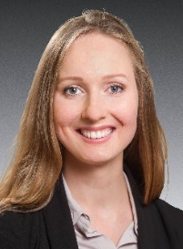
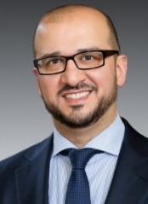
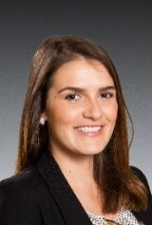
Europe, Middle East, and Africa Headquarters
Amsterdam, the Netherlands
Phone: +31 (0)20 509 1070
Timothy S. Mescon, Ph.D.
Senior Vice President and Chief Officer EMEA
Tim.Mescon@aacsb.edu
Tara Jongma
Manager, Member Services and Operations EMEA
Tara.Jongma@aacsb.edu
Marine Condette
Manager, Accreditation and Member Services EMEA
Marine.Condette@aacsb.edu
Olga Sholderer
Associate, Administration and Data Services EMEA
Olga.Sholderer@aacsb.edu
Ihsan Zakri Manager, Accreditation and
Member Services EMEA Ihsan.Zakri@aacsb.edu
Fanny Vladimirova
Associate, Member Services EMEA
Fanny.Vladimirova@aacsb.edu
Ivana Batista
Associate Seminars EMEA
Ivana.Batista@aacsb.edu

Slide 8
AACSB International Europe, Middle East & Africa Amsterdam, the Netherlands
Total educational AACSB members: 400
195 private institutions
205 public institutions
23% - AACSB EMEA educational members in the AACSB accreditation process.
31% - AACSB EMEA educational members hold AACSB accreditation.
Since January 2015
25 newly accredited – 14 countries
104 new members – 44 countries

Slide 9
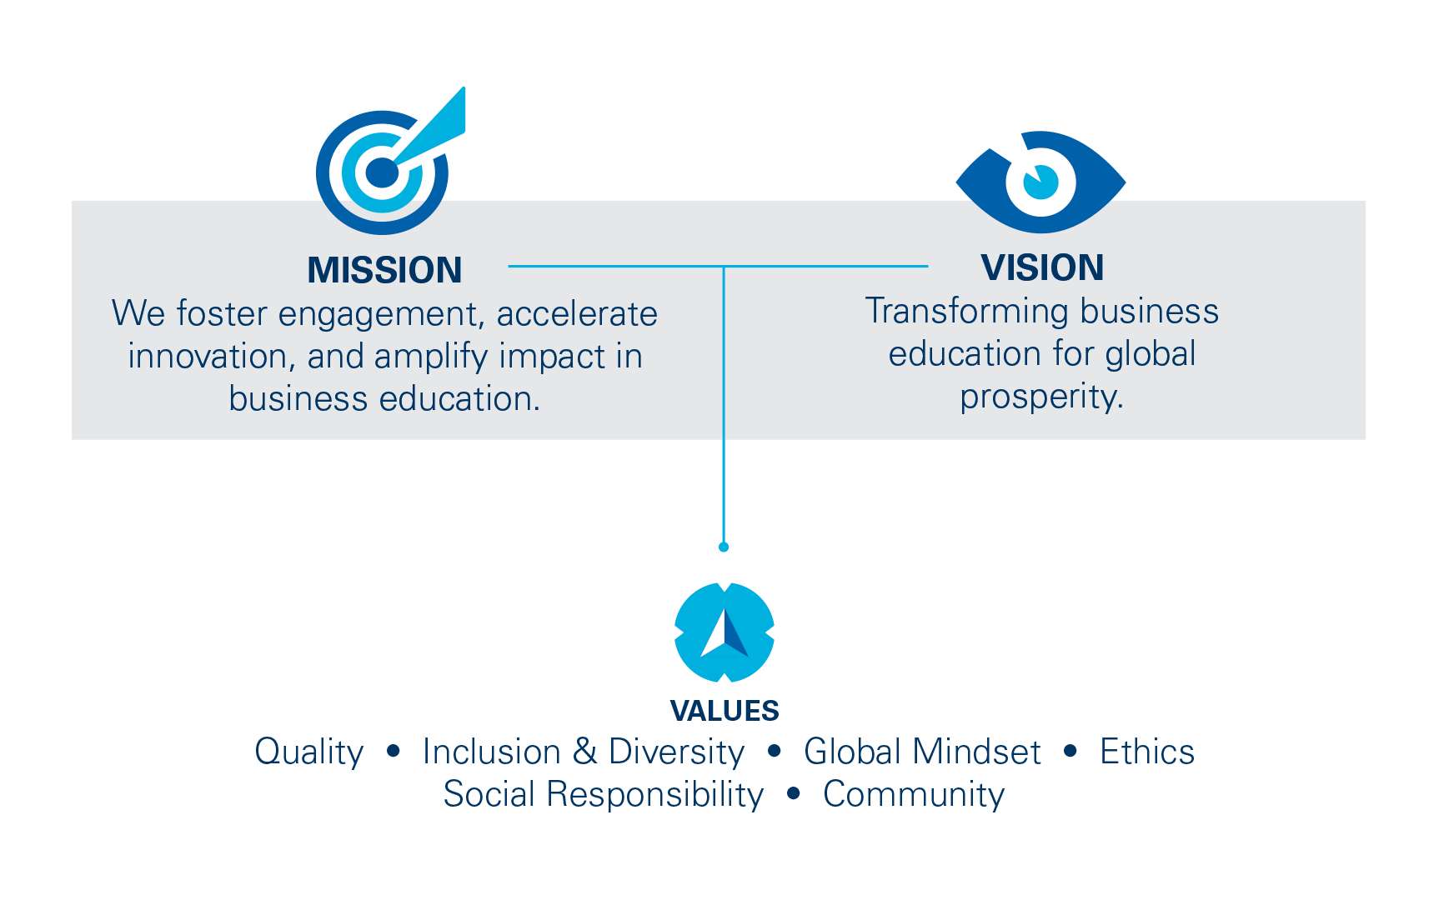
Inspiring Transformation
Notes:
The VISION of AACSB International is to transform business education for global prosperity. Business and business schools are a force for good, contributing to the world’s economy and to society, and AACSB International plays a significant role in making that benefit better known to all stakeholders − serving business schools, students, business and society.
The MISSION of AACSB International is to foster engagement, accelerate innovation, and amplify impact in business education.
aligned with AACSB accreditation standards for business schools.
AACSB strives to continuously improve engagement among business, faculty, institutions, and students so that business education is aligned with business practice.
To fulfill this goal, AACSB International will encourage and accelerate innovation to continuously improve business education. As a result, business education will have a positive impact on business and society − and AACSB will amplify that impact.
In achieving its mission and vision, AACSB will emphasize and model the following
VALUES: Quality, Inclusion & Diversity, a Global Mindset, Ethics, Social Responsibility, and Community.
These values will drive AACSB’s future initiatives and interactions with the business education community worldwide.
[not included in the image, but for reference]
Over the next few years, AACSB International will focus strategically on five key customer‐focused areas as well as key enablers to deliver on our mission:
Quality Assurance & Quality Improvement (Accreditation)
Advocacy & Awareness
The AACSB Network
Professional Development
Business Education Intelligence
Enablers

Slide 10
Notes:
In April of this year, AACSB unveiled a collective vision for business education, which serves as a guiding framework for business schools, as they adapt to the significant shifts within the broader higher education landscape, and re-imagine their purpose in society.
Some of the major questions that the vision aims to address are:
How does this vision strengthen my ability to prepare tomorrow’s leaders?
How does it help me address the changes and challenges that have become business as usual in business education?
How will it help my school, and our industry, thrive?

Slide 11
Cultivate a Position at the Intersection of Academia and Practice
Drive Innovation in Higher
Education
Connect With
Other Disciplines
Notes:
VISUALS: Automatic motion included in slide. Each hexagon represents an activator to help seize the opportunities.
So, are you Intrigued? Inspired? Can you envision this future?
Now let’s talk about how we’re going to get there.
We have the opportunity to stretch the boundaries by which we’ve traditionally defined ourselves.
Business schools have expertise in a wide range of areas and disciplines. We’re going to claim this additional expertise, own it.
Business schools have a societal purpose. To expand this purpose, we have the opportunity to think, organize and act in new ways.
Some schools will discover uncommon strategies and solutions. Our vision encourages that diversity.
By seizing areas of opportunity based on each school’s unique cultural, political, economic and financial context, we will set the standard for a new concept of business education.
And now, here are Activators to help you get there. Activators are actions that accelerate your growth.
Activator 1: Cultivate a position at the intersection of academia and practice.
We have an opportunity to engage across industries and sectors to claim the rich space between theory and practice.
For some schools, building academic rigor will be key. For others, the focus will be on strengthening relationships.
We will move business schools from being suppliers of talent to being co-educators and co-creators of ideas, understanding, innovation and entrepreneurship.
Activator 2: Drive innovation in higher education.
New approaches to education, knowledge creation and outreach will require different models for faculty and staffing, education and credentialing, funding and more.
We understand that higher education has its own structures and support systems.
Yet within these systems, we have an opportunity to actively create new systems, standards and traditions.
Through working together, moving from independence to interdependence, we can help lead the transformation.
Activator 3: Connect with other disciplines.
No one discipline can single-handedly solve every challenge. We must work together.
For instance, when we offer to help create management programs in engineering, healthcare or other schools, the combined effort benefits everyone involved.
We’re also serving the needs of students who increasingly seek dual degrees.
And this is more than course delivery. This involves industry outreach and engagement, and thinking differently about how we connect with outside experts.

Slide 12
Diverse Models
New Metrics
Clarity of Purpose
Social Impact
Economic Impact
Notes:
VISUALS: Automatic motion included in slide to feature icons depicting potential outcomes.
What Does Success Look Like?
We’ll see school segmentation and differentiation aligned with increasingly diverse models of organization.
Schools will be experimenting with different models for faculty and staffing, education and credentialing, and funding, until they find the best match for the diversity in their community.
We’ll see deeper collaboration with disciplines inside and outside of business.
We’ll witness a changing definition of what a business school is—and changes in how the world interacts with us.
We’ll see new metrics for business school impact and success.
We’ll move beyond graduate salaries to measure jobs created, businesses started and more.
We’ll use new platforms to assess quality across multiple dimensions.
With this wider range of metrics, we’ll be encouraged to pursue mission- and purpose-driven strategies.
Expectations of transparency will increase. Schools will have to show customers and supporters directly how they deliver on their promises.
We’ll see a stronger focus on clarity of purpose and social impact.
This will strongly position business schools as trusted partners in finding solutions to global challenges.
Businesses large and small, including entrepreneurs and microenterprises, will see business schools as relevant—even critical.
That’s because we’ll be contributing to greater economic impact.
Each of these opportunities gives us a boost as we help more students get precisely the skills they need to succeed.
We’ll encourage entrepreneurship in new ways.
And with our commitment to social good, we’ll have a greater effect on our communities and the wider society.

Slide 13
A Collective Vision for Business Education
Catalysts for Innovation
Co-Creators of Knowledge
Enablers of Global Prosperity
Leaders on Leadership
Hubs of Lifelong Learning
Notes:
VISUALS: Slide will open with hexagon grid featuring all 5 opportunities. Next click will put the focus on the first opportunity, “Catalysts for Innovation.” Third click will transform the slide into a word cloud, highlighting key terms related to the opportunity. Same sequence will repeat with each opportunity.
In the vision development process, we identified five opportunities for bringing the vision to life. Each one has vast benefits for your school.

Slide 14
Be Part of the Global Network
Quality Assurance & Quality Improvement (Accreditation)
Global Network
Affinity Groups
Exchange
Collaboration Concourse
Volunteer Opportunities
Business Education Intelligence
Industry reports
DataDirect database
Country profiles
BizEd Magazine
Professional Development Events
Conferences
Seminars
Webinars & eLearning
Exhibiting & Sponsorship
Career Services
BizSchoolJobs.com
Advertising

Slide 15
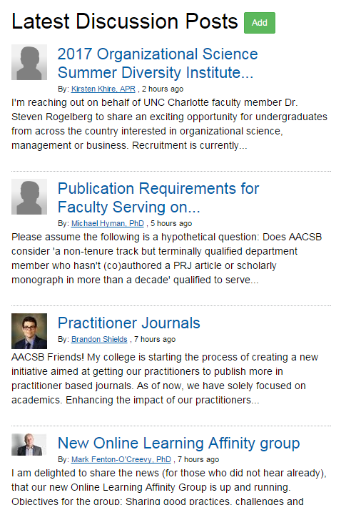
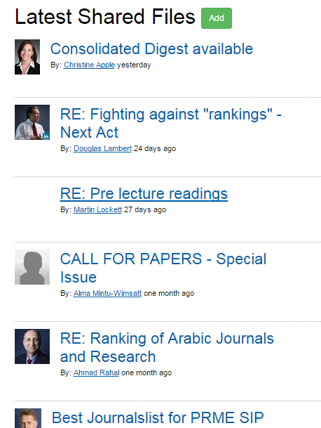
AACSB Exchange: Get Connected
Share Materials
Find Solutions
Discuss Experiences
Notes:
AACSB Member Forum
Your connection to an incredible resource - 33,000+ of your colleagues who share your challenges, uncertainties, and successes.
Builds on the value of networking and educational opportunities we provide through our conferences, seminars, regional events, and online communities throughout the year→ additional level of member collaboration, this online community allows AACSB members worldwide to connect, engage and share experiences, industry information and best practices, seek and share advice, exchange resources and build relationships.
The AACSB Member Forum is an evolving collaborative community and your participation will enhance its value and strengthen this network of members worldwide.
E-mail notifications daily by default – manage in my subscriptions under your profile

Slide 16
AACSB Exchange: Collaboration Concourse
Find institutions that want to collaborate with your school!
Study Abroad
Twinning Agreement
Faculty Activity
Joint Degrees
Notes:
AACSB Member Forum
Your connection to an incredible resource - 33,000+ of your colleagues who share your challenges, uncertainties, and successes.
Builds on the value of networking and educational opportunities we provide through our conferences, seminars, regional events, and online communities throughout the year→ additional level of member collaboration, this online community allows AACSB members worldwide to connect, engage and share experiences, industry information and best practices, seek and share advice, exchange resources and build relationships.
The AACSB Member Forum is an evolving collaborative community and your participation will enhance its value and strengthen this network of members worldwide.
E-mail notifications daily by default – manage in my subscriptions under your profile

Slide 17
Affinity Groups
Collaborate with peers in the same region or with the same interests, online and in person.
European
Small Schools
Middle East and North Africa
New Deans
Associate
Deans
& more
Notes:
AACSB Member Forum
Your connection to an incredible resource - 33,000+ of your colleagues who share your challenges, uncertainties, and successes.
Builds on the value of networking and educational opportunities we provide through our conferences, seminars, regional events, and online communities throughout the year→ additional level of member collaboration, this online community allows AACSB members worldwide to connect, engage and share experiences, industry information and best practices, seek and share advice, exchange resources and build relationships.
The AACSB Member Forum is an evolving collaborative community and your participation will enhance its value and strengthen this network of members worldwide.
E-mail notifications daily by default – manage in my subscriptions under your profile

Slide 18
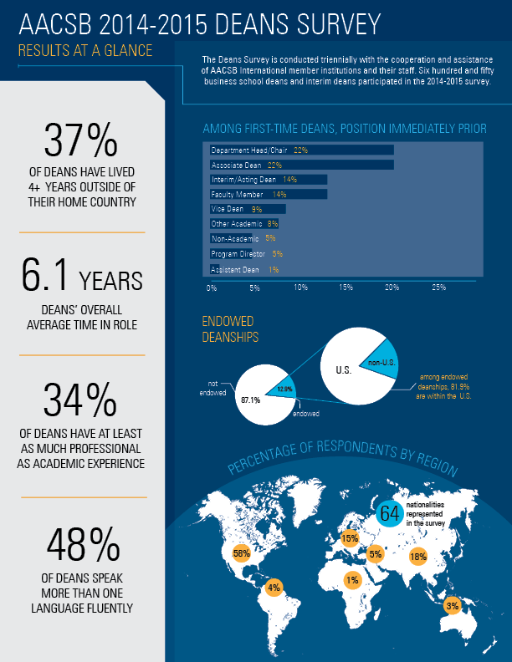
Types of Data Available
Students
Admissions, Enrollment, Degrees Conferred, Employment, Demographics, Class Sizes
Programs
Education Levels, Degree Titles, Delivery Methods
Faculty, Administrators, Staff
Demographics, Numbers Employed, Teaching Loads, Compensation and Salary data (aggregated)
General Institution Data
Institutional Control (Public vs. Private), Accreditation Status, Location, Mission and Research Priorities, Operating Budgets, Endowments, Uses and Sources of Funds, Effective Practices, Partnerships and Collaborations (Existing & Desired)
Notes:
The various surveys that AACSB regularly runs via DataDirect collectively gather a wealth of data from participating schools. They include data on Students at all levels; Degree programs of all levels and all delivery methods; Statistics on various categories of Faculty, Administrators, and Staff; and General data pertaining to the institutions that participate in the surveys.
AACSB also conducts a number of ad hoc surveys, or ones that span a few years, for example the Deans Survey which is conducted every 3 years. Most recent was launched at the end of 2014 and provides a profile of the business school dean. In the 2014-15 survey, 650 business school deans and interim deans participated.

Slide 19
Using the Data
Determine your peers and aspirants for continuous improvement benchmarking and/or quality assurance purposes
Find potential collaborative partners
Understand trends in the management education industry
Doctoral faculty demand
Popularity of different degree types
Operating budget trends
Notes:
As an AACSB member, regardless of accreditation status, the data AACSB collects can be useful to you in a number of ways:
Identify business schools with similar characteristics that may be peer or aspirant schools.
Find other AACSB member schools that are looking for partnerships with schools like yours.
Understanding trends related to the industry; e.g., doctoral faculty production, enrollment levels in various types of programs, or trends in operating budget levels.
******most importantly, we have a dedicated DataDirect team in place to assist you with accessing the site at anytime.

Slide 20
Professional Development Seminars
Accreditation, Quality Assurance, and Impact
Professional Development
Curriculum Development Series
Pedagogy Development & Online Learning
Strategic Management Seminar
2-3 April 2017 | Dubai, UAE
Business Accreditation Seminar
15 – 16 March 2017 | London, England
4-5 April 2017 | Dubai, UAE
Assurance of Learning I Seminar
20 – 21 June 2017 | Amsterdam, the Netherlands (AoL I)
22 – 23 June 2017 | Amsterdam, the Netherlands (AoL II)
Leading in the Academic Enterprise™ Series
Strategic Thinking and Creative Problem Solving
13 – 14 March 2017 | London, England
Developing Leaders and Impactful Communication
11 – 12 May 2017
Online Teaching Effectiveness Seminar
18 – 19 May 2017 | Amsterdam, the Netherlands

Slide 21
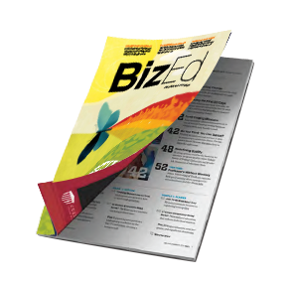
BizEd Magazine
An Award-winning magazine with insights into business education.
Focused on trends, ideas, and developments in the business education industry.
A place for educators and stakeholders to discover best practices, emerging concepts, and the latest news.

Slide 22
AACSB Accreditation
Proves your commitment to quality and continuous improvement
Produces graduates who have achieved specified learning goals
Ensures currency of curricula and importance of quality teaching

Slide 23
Accreditation is . . . .
Mission-driven
Principles based rather than rules based
Peer review – multiple levels
Focused on continuous improvement
Staff supported

Slide 24
Purpose of Accreditation
Promote high quality and continuous improvement supported by engagement, innovation, and impact.
Use internal self-assessment and external peer review to confirm delivery of high quality management education and overall mission achievement.

Slide 25
Value of Accreditation
Cultivates meaningful interactions between
students and a qualified faculty
Produces graduates who have achieved
specified learning goals
Ensures currency of curricula and importance
of quality teaching
Makes a statement to external communities
about your commitment to quality and
continuous improvement
Notes:
Some features of AACSB accreditation. Again, the focus is on quality and continuous improvement. Accreditation process is mission driven and therefore supports and encourages variety in mission statements. AACSB has a very diverse population of accredited schools (i.e. top research institutions, teaching schools, large, small, etc.). Research and the advancement of knowledge is also a central tenet in AACSB accreditation. Quote Jerry: research is a non-negotiable aspect of accreditation and we will discuss this later on. Also currency of the curriculum and its ability to prepare students not only for the present but also the future is important.

Slide 26
Delivering Relevant & High-Quality Management Education: 3 Themes
Engagement
Innovation
Impact
Notes:
AACSB’s 2013 Standards, which focus on engagement, innovation, and impact, can help us meet the new challenges and opportunities, mitigating and taking advantage of disruptive forces. By being better engaged with business, we can keep our finger on the pulse of management needs and make sure we are “in the loop” for potential disruptions. By being innovative, schools can maximize the possibility that they are prepared for and can benefit from disruptions. We know in science and fields like venture capital, there are potentially high returns to innovation—whether on a large-scale experimentation or through “little bets.” As a result, business schools can make the positive impact on business, society, and their graduates that they were created to make.

Slide 27
3 Accreditation Themes
1. Engagement
High quality education results when there is significant on-going engagement with the professional and academic worlds.
AACSB accreditation encourages the intersection of engagement consistent with the school’s mission.
Notes:
Shared common purpose across all b schools is the preparation of students for meaningful professional, social and personal lives
Criterion B UNDER Part 1: Core Values and Guiding Principles- page 5 accreditation standards- COLLEGIATE ENVIRONMENT
Standard 1: The school articulates a clear and distinctive mission, the expected
outcomes this mission implies, and strategies outlining how these outcomes will be
achieved. The school has a history of achievement and improvement and specifies future
actions for continuous improvement and innovation consistent with this mission,
expected outcomes, and strategies. [MISSION, IMPACT, AND INNOVATION]

Slide 28
Accreditation Themes
2. Innovation
Foster quality, but not at the expense of creativity, experimentation, and innovation.
Innovation is encouraged and should lead to improvements and high quality.
Notes:
Standard 1: The school articulates a clear and distinctive mission, the expected outcomes this mission implies, and strategies outlining how these outcomes will be achieved. The school has a history of achievement and improvement and specifies future actions for continuous improvement and innovation consistent with this mission, expected outcomes, and strategies. [MISSION, IMPACT, AND INNOVATION]
Global partnerships
What are other examples?

Slide 29
Accreditation Themes
3. Impact
Environment of increasing accountability.
Must focus on high quality inputs and resulting outcomes.
Show how the school is making a difference and having impact.
Areas of impact: mission, assurance of learning, curriculum, degree programs, research, teaching, students, and community.
Notes:
Be aware of focus first on high quality inputs (human, financial, physical) and the outcomes of those inputs within the context of the b schools mission and strategies

Slide 30
AACSB Accreditation: 15 Standards
Strategic Management and Innovation (Standards 1-3)
1. Mission, Impact and Innovation
2. Intellectual Contributions and Alignment with the mission
3. Financial Strategies and Allocation of Resources
Participants: Students, Faculty and Professional Staff (Standards 4-7)
4. Student Admissions, Progression, and Career Development
5. Faculty Sufficiency and Deployment
6. Faculty Management and Support
7. Professional Staff Sufficiency and Deployment
Learning and Teaching (Standards 8-12)
8. Curricula Management and Assurance of Learning
9. Curriculum Content
10.Student Faculty Interactions
11.Degree Program Educational Level, Structure & Equivalence
12.Teaching Effectiveness
Academic and Professional Engagement (Standards 13-15)
13.Student Academic and Professional Engagement
14.Executive Education
15.Faculty Qualifications and Engagement

Slide 31
AACSB Accreditation Standards: Strategic Management and Innovation
1
Mission, Impact, and Innovation
Clear and distinctive mission that drives the actions of the business school and leads to impact and innovation.
2
Intellectual Contributions & Alignment with Mission
High quality, impactful intellectual contributions, consistent with mission.
3
Financial Strategies and Allocation of Resources
Financial resources sufficient to achieve mission.

Slide 32
AACSB Accreditation Standards: Participants—Students, Faculty, and Professional Staff
4
Student Admissions, Progression & Career Development
Student admission standards, other systems in place to ensure student success during and after studies.
5
Faculty Sufficiency & Deployment
Sufficient faculty to ensure quality outcomes.

Slide 33
AACSB Accreditation Standards: Participants—Students, Faculty, and Professional Staff
6
Faculty Management & Support
Systems in place to effectively manage and support faculty throughout their career.
7
Professional Staff Sufficiency & Deployment
Sufficient professional staff to ensure quality outcomes.

Slide 34
AACSB Accreditation Standards: Learning and Teaching
8
Curricula Management & Assurance of Learning
Accountability standard; ensures student outcomes are achieved and continuous improvement processes are in effect for managing degree programs.
9
Curriculum Content
Ensures that the content of curriculum is appropriate given the degree program and goals.

Slide 35
AACSB Accreditation Standards: Learning and Teaching
10
Student-Faculty Interactions
Curricula designed to facilitate interactions between students and students and faculty.
11
Degree Program Educational Level, Structure, & Equivalence
Degree programs are structurally sound and ensure achievement of learning outcomes.
12
Teaching Effectiveness
Processes are in place to enhance teaching effectiveness of faculty.

Slide 36
AACSB Accreditation Standards: Academic and Professional Engagement
13
Student Academic & Professional Engagement
Curricula facilitates student engagement with academic and professional communities.
14
Executive Education
Programs complement degree programs and there are processes to ensure client satisfaction (5% rule)
15
Faculty Qualifications & Engagement
Faculty demonstrate academic and professional experience to support quality outcomes consistent with mission.

Slide 37
ELIGIBILITY CRITERIA Requirements to begin accreditation journey
A: Ethical Behavior
Establishing a fundamental expectation
B: Collegiate Environment
Advanced level, engagement, and faculty involvement
C: Commitment to Corporate and Social Responsibility
Fostering responsibility in society
D: Accreditation Scope and AACSB Membership
Flexibility and criteria
E: Oversight, Sustainability, and Continuous Improvement
Foundations and context for accreditation review
F: Policy on Continued Adherence to Standards and Integrity of Submissions to AACSB, consistency and integrity
Notes:
Complete Eligibility Application (EA) using MyAccreditation
EA accepted throughout the year - reviewed by Committee four times per year

Slide 38
The Successful Accreditation Journey for AACSB International Members- 15 Stages
Institutional Accreditation Scope or in rare exceptions file for Unit of Accreditation
Review and complete the Eligibility Application (EA), 15-pages of questions that when completed should not exceed 50 pages. Submission is done virtually.
Accreditation Manager reviews submitted EA document and sends to Initial Accreditation Committee (IAC).
IAC approves the EA and immediately:
a. School is assigned a Staff liaison - Accreditation Manager
b. School is assigned a Mentor/Advisor from an AACSB accredited school
A Clock starts. School has maximum 2 years to complete Initial Self Evaluation Report (ISER) and 7 years to complete the accreditation journey.

Slide 39
The Successful Accreditation Journey- 15 Stages
Mentor immediately works with the Dean and the school on a “gap analysis”, a classical consulting report that evaluates the school’s performance v AACSB’s 15 accreditation standards
The gap analysis is the beginning of the creation of the Initial Self Evaluation Report (ISER)
School will work on revising/refining this original ISER until ready for a formal accreditation visit
Final ISER is submitted to Initial Accreditation Committee
School continues to work on ISER and submits regular reports defined by IAC, generally 6 months later.

Slide 40
The Successful Accreditation Journey- 15 Stages
At some point the Mentor, the Accreditation Manager, and the Dean agree the ISER is completed and the IAC agrees and a Peer Review Team (PRT) is assigned.
Peer Review Team schedules a visit to school sometime in the next year
2 ½ day PRT visit occurs
PRT team submits recommendation to IAC
IAC submits recommendation to AACSB Board

Slide 41
Accreditation Timeline
Initial Accreditation
Establish eligibility and early stage readiness
Feedback provided by Initial Accreditation Committee and mentor
2 years
3 years
2 years
School documents readiness for initial accreditation
Feedback from Initial Accreditation Committee and mentor
allowed for initial self-evaluation report
allowed for readiness
allowed for final self-evaluation report and review
Continuous Improvement Review
Review occurs every
5 years
Must document continuous improvement
Standards alignment expected
Strong focus on consultative feedback and continuous improvement
Notes:
Link to Initial Accreditation page: http://www.aacsb.edu/accreditation/business/initial-accreditation.aspx
Link to CIR page: http://www.aacsb.edu/accreditation/business/continuous-improvement-review/

Slide 42
The Committee Process (all AACSB volunteers)
Initial Accreditation Committee (IAC)
February, April, August, November
Accounting Accreditation Committee (ACC)
January, June
Continuous Improvement Review Committee (CIRC)
January, June
Committee on Accreditation Policy (CAP)
January, April and September
Notes:
IAC meets: January/February, April, July/August & October/November
CIRC meets: January and June
AAC meets January and June
CAP meets: January, April and September

Slide 43
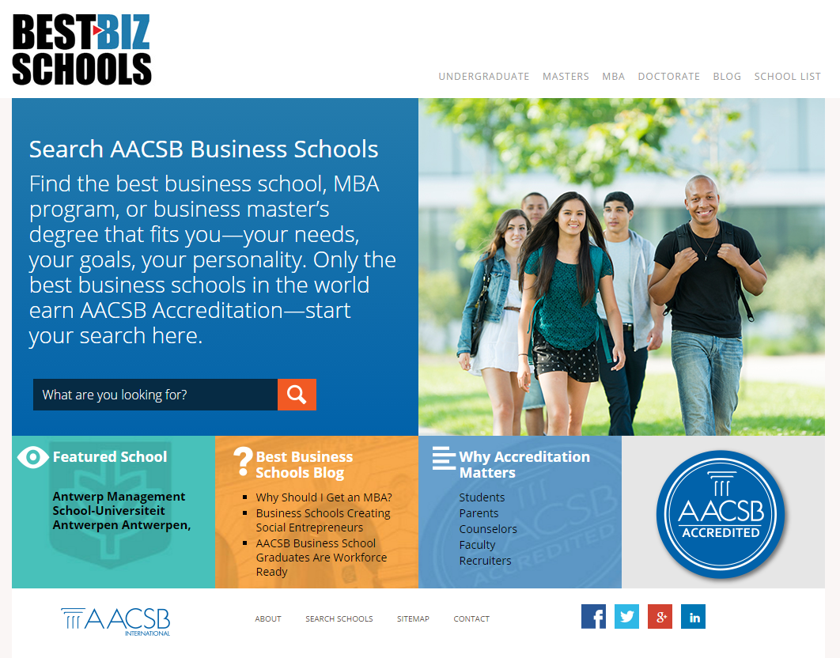
Marketing the Value of Accreditation
A student resource for finding AACSB Accredited schools worldwide
School Search
Why Accreditation Matters
Student Blog

Slide 44
AACSB International Membership & Quality Assurance
Questions?

